Slide 1
SolidWorks DFM Plug-In
Ruoyu Song
Dr. Cassandra Telenko
Aniruddh Marellapudi

Slide 2
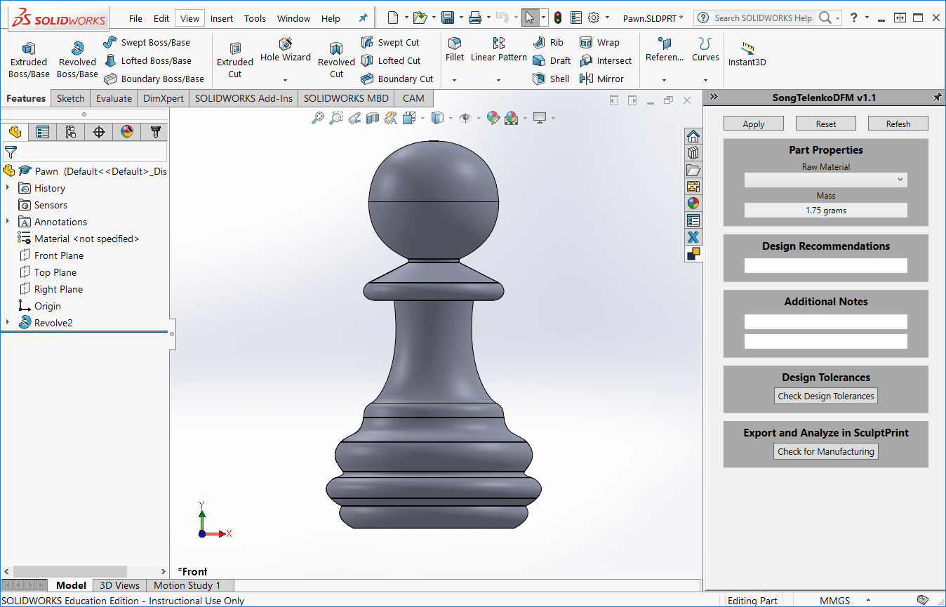

Slide 3
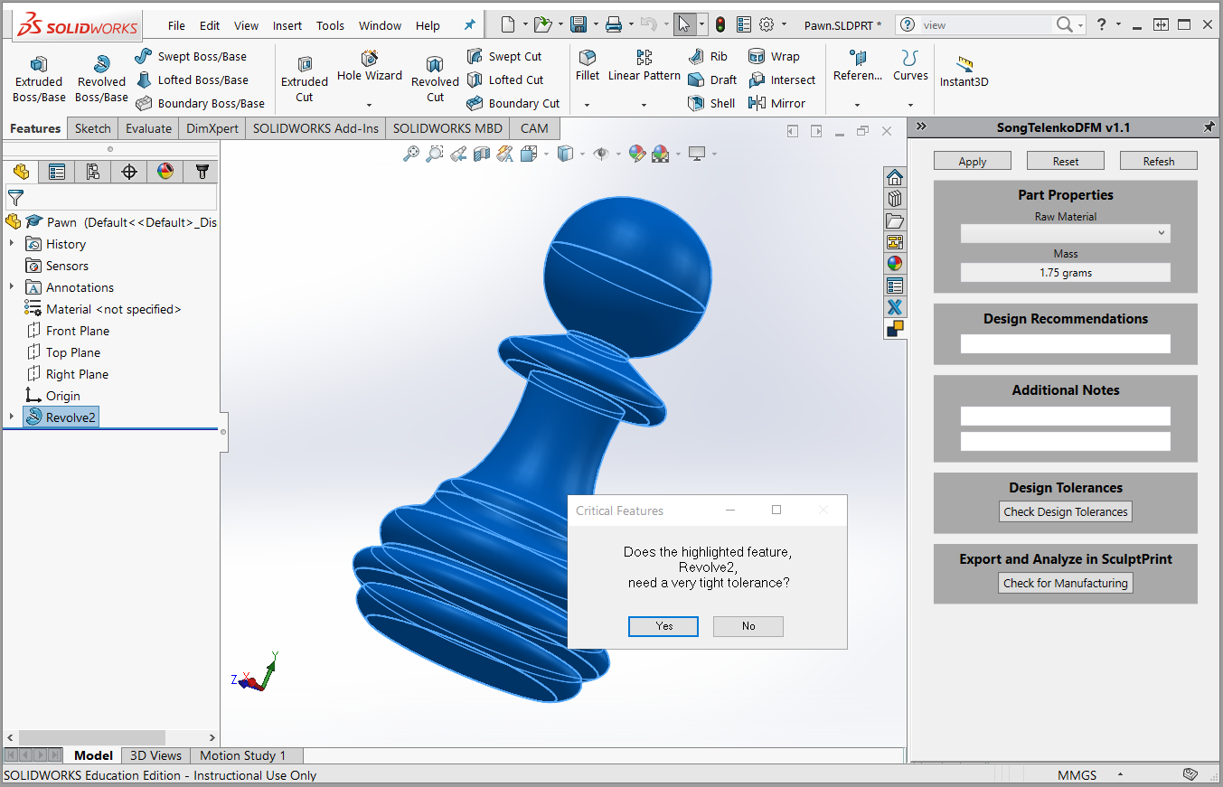

Slide 4
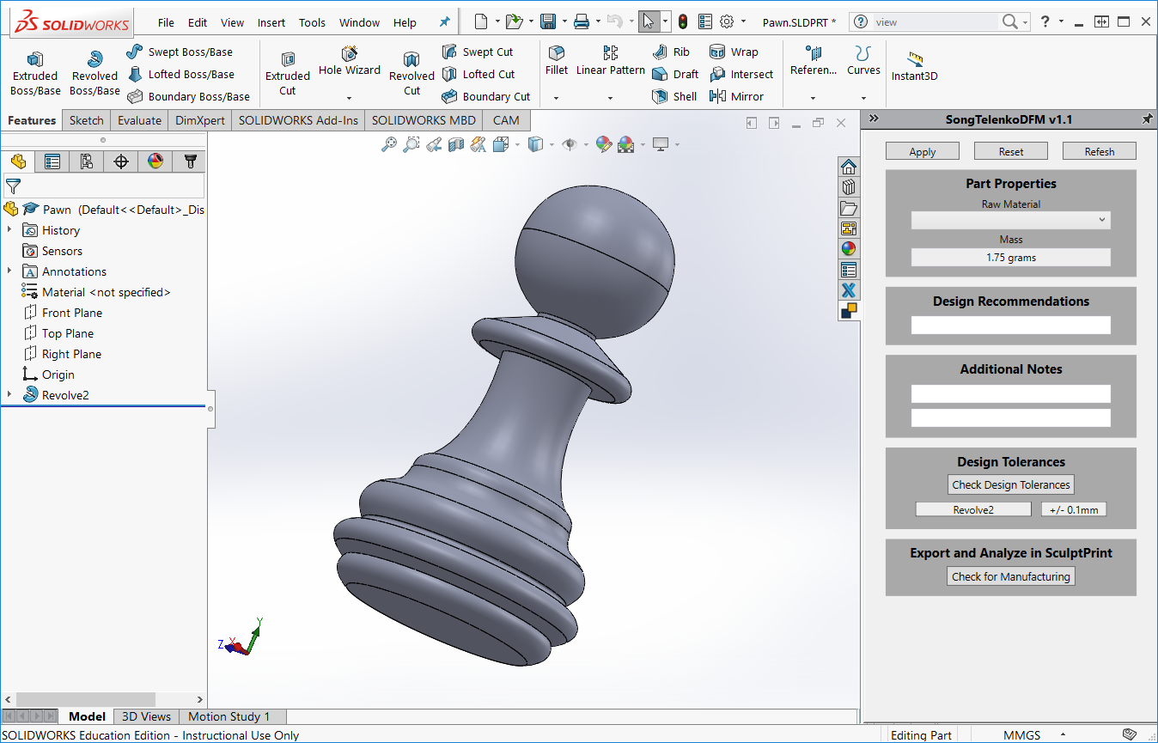

Slide 5
